Slide 1
Creative Commons (CC) : A New Model for Copyright Management
Professor Brian Fitzgerald
Head of School of Law QUT

Slide 2
CC: Key Themes
Sharing, Accessing, Collaborating and Negotiating: Content, Knowledge, Culture and Production – “with a minimum of fuss”
Fueled by the negotiability, innovation and creative potential of the digital environment – “cut and paste”, “remix” “P2P”
Free Culture – Free to Access – a repository of open space or commons unencumbered by large transaction costs and threats of law suits - Lessig, The Future of Ideas (2001); Free Culture (2004)
Creative Innovation – core economic driver – Florida, Rise of the Creative Class (2002) – CC slogan “get creative”
Peer to Peer Production and User Led Innovation - Y Benkler, “Coase's Penguin, or Linux and the Nature of the Firm”, (2002) 112 Yale Law Journal 369 – Collaborative Innovation
Grass Roots support and Community participation

Slide 3
Free and Open Source Software
“The powerful insight that Richard Stallman and his advisers at the Free Software Foundation .. discovered was that if you want to structure open access to knowledge you must leverage off or use as a platform your intellectual property rights. The genius of Stallman was in understanding and implementing the ethic that if you want to create a community of information or creative commons you need to be able to control the way the information is used once it leaves your hands. The regulation of this downstream activity was achieved by claiming an intellectual property right (copyright in the code) at the source and then structuring its downstream usage through a licence (GNU GPL). This was not a simple “giving away” of information but rather a strategic mechanism for ensuring the information stayed “free” as in speech. It is on this foundation that we now see initiatives like the Creative Commons expanding that idea from open source code to open digital content.”: A Fitzgerald and B Fitzgerald Intellectual Property in Principle (2004) at [11.100].

Slide 4
Four main protocols
Attribution: Other people may use, modify and distribute the work, as long as they give the original author credit.
Non-commercial: Other people may use, modify and distribute the work, but for non-commercial purposes only.
No derivatives: Other people may use and distribute the work, but can not modify it to create derivative works.
Share alike: Other people may modify the work and distribute derivatives, but only on the condition that the derivatives are made available to other people on the same licence terms. This term can not be used with the No Derivatives term, because it applies only to derivative works.
Need to mention Moral Rights (asserted) in Australian licence

Slide 5
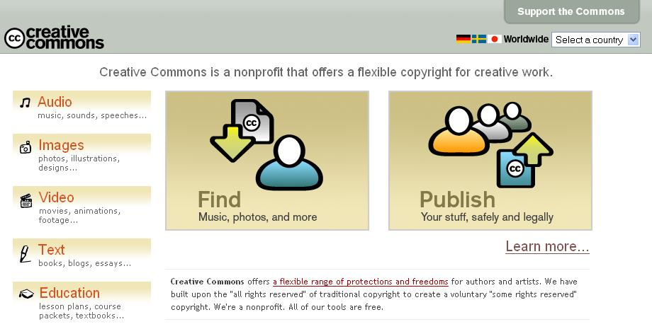

Slide 6
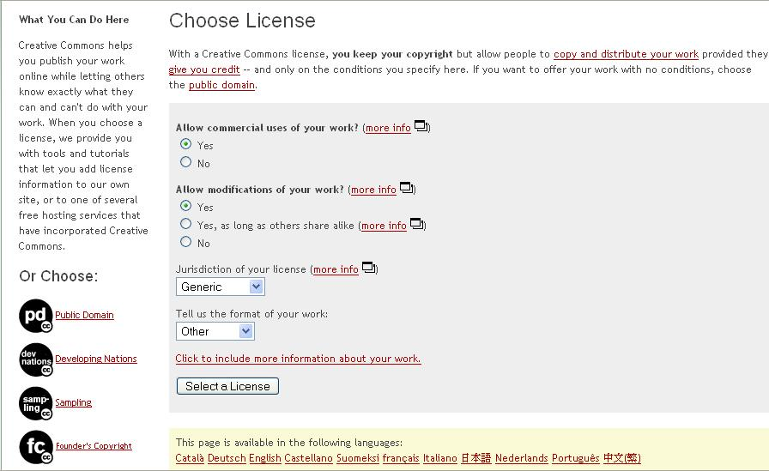

Slide 7
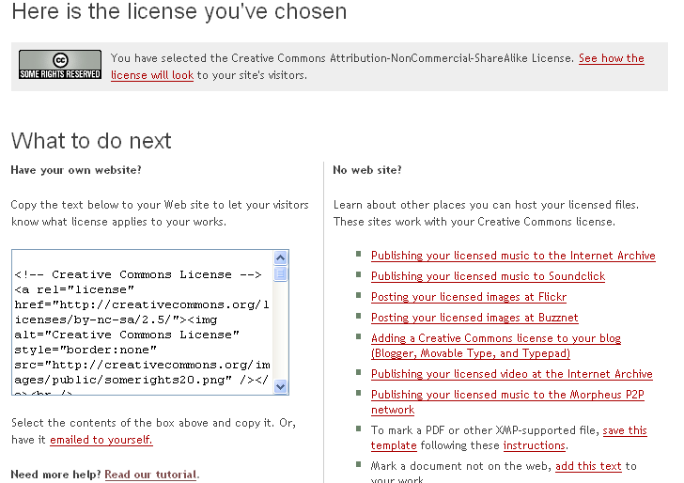

Slide 8
CC Badge

Slide 9
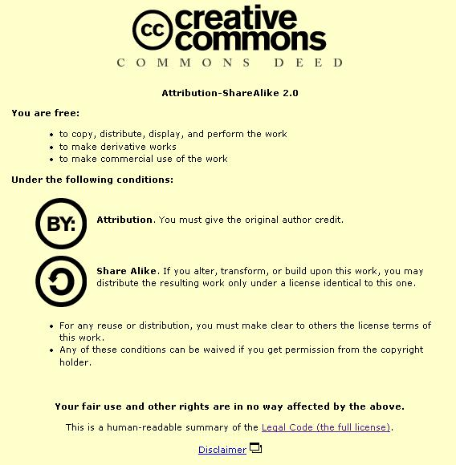

Slide 10
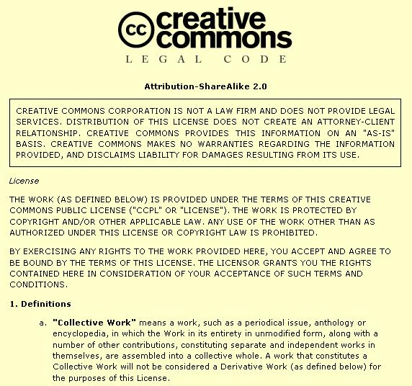

Slide 11
Wired Magazine
Wired magazine has produced a compact disc where the work of artists and bands are distributed under Creative Commons licences. The Wired CD was released together with the November 2004 of Wired Magazine.Sixteen recording artists agreed to participate in this project and contribute their work for inclusion on the Wired CD.
There are two different licences under which tracks on the Wired CD are distributed. Thirteen recording artists chose to distribute their work under the Sampling Plus Licence. Three recording artists chose to distribute their work under the Noncommercial Sampling Plus Licence.

Slide 12

“My Life”
Colin Mutchler contributed an acoustic guitar melody to Opsound, called ‘My Life’

Slide 13
“My Life Changed”
Cora Beth came across the track and added a violin part, calling it “My Life Changed”

Slide 14
“Our Lives Are Changing”
rjmarshall remixed the track and several others from the Opsound pool, and created “Our Lives Are Changing”

Slide 15
“The Big Finale”
John Holowach remixed the remix, and created “The Big Finale”

Slide 16
Dean Gray – American Edit
Dr Who on Holiday
  Samples - Speech by George W. Bush
  Samples - Speech by The Daleks
  Samples - Green Day, "Holiday"
  Samples - The Timelords, "Doctorin' the Tardis"
  Samples - Gary Glitter, "Rock and Roll (Part 2)"

Slide 17
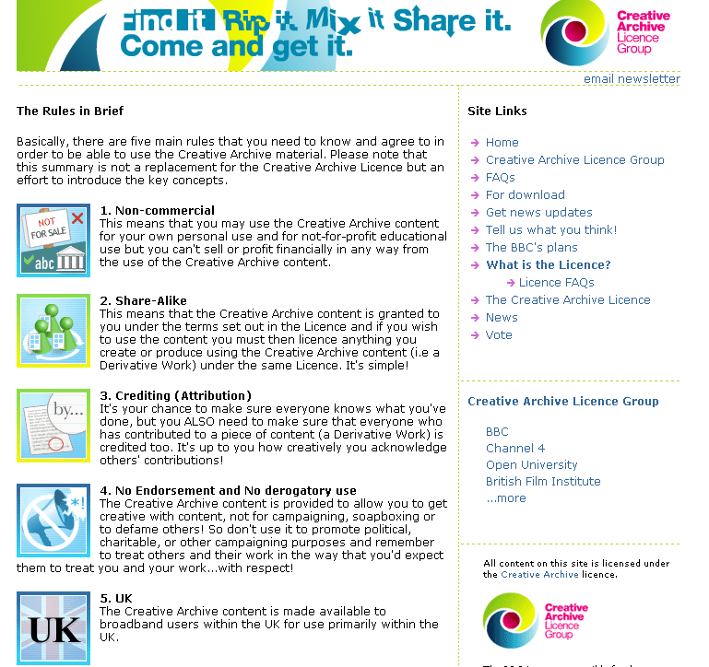

Slide 18
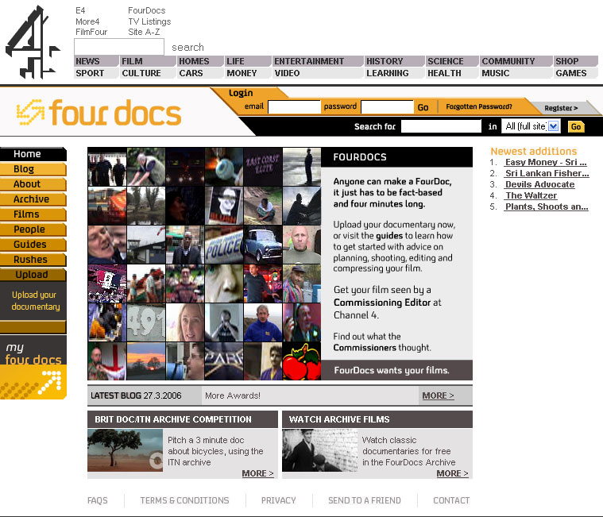
Fourdocs
(http://channel4.com/fourdocs/)
Individual users create and upload four minute documentaries
Documentaries are reviewed by professional editors

Slide 19
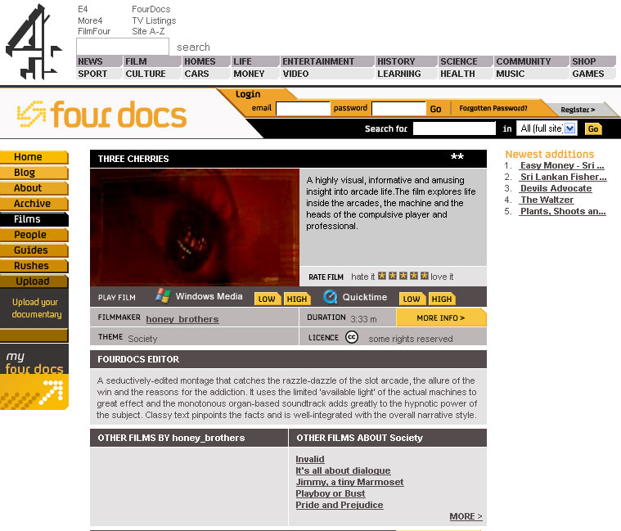
Fourdocs
All documentaries available under CC-BY-NC-ND
Allows users to download, rate, and review the films

Slide 20
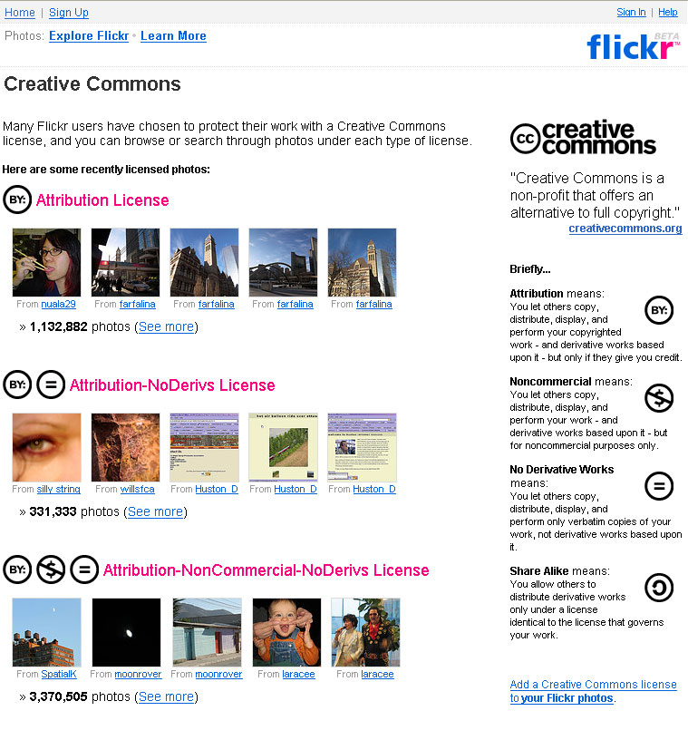
flickr.com
Over 10 Million photos licensed under CC licences

Slide 21
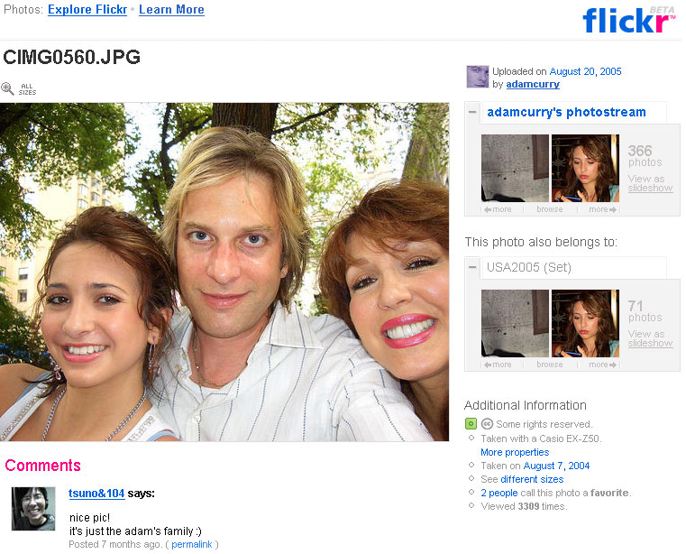
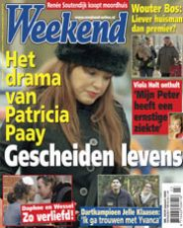
Creative Commons win in Dutch Court – 09 March 2006
Weekend magazine published four photos taken from Adam Curry’s flickr photostream (BY-NC-SA)
Dutch court upheld CC licence: “All four photos that were taken from www.flickr.com were made by Curry and posted by him on that website. In principle, Curry owns the copyright in the four photos, and the photos, by posting them on that website, are subject to the [Creative Commons] License. Therefore [the publisher] should observe the conditions that control the use by third parties of the photos as stated in the License.”

Slide 22
Revver.com – The New Business Model
The Extreme Diet Coke Experiment

Slide 23
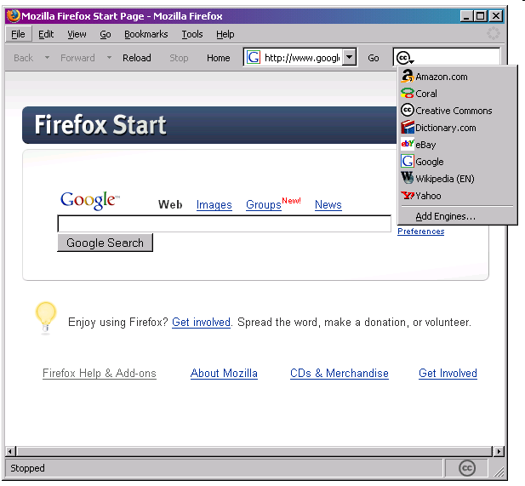

Slide 24
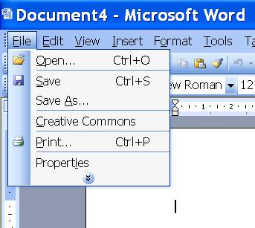

Slide 25
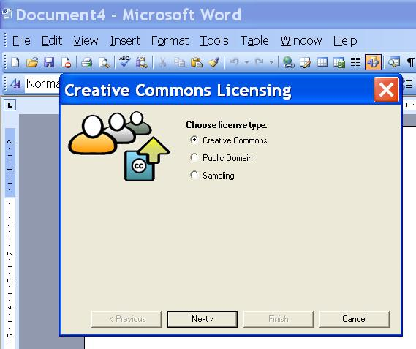

Slide 26
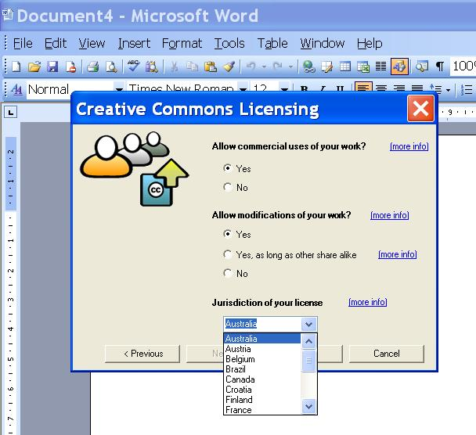

Slide 27
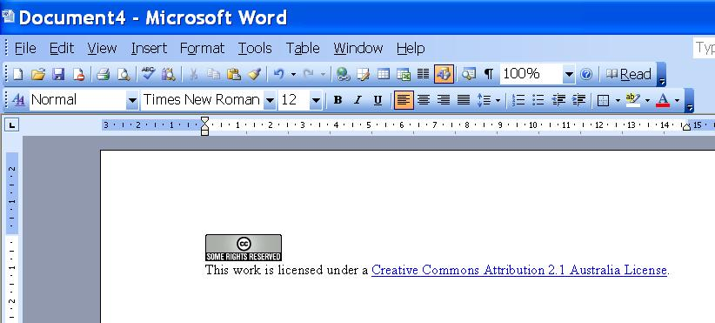

Slide 28
Application to Public Sector Information Management
Government Copyright Material
Publicly Funded Research
Open Education
Public Funded Archives
EU Directive on Reuse of and OECD Work on Public Sector Information (PSI) Management
UK Common Information Environment (CIE) – CC in the UK Public Sector

Slide 29
Relationship to Copyright
Not anti-copyright
Relies on and is complementary to copyright
Aims to make copyright more alive active and accessible
Mentioned in recent cases: MGM v Grokster (US Supreme Court); Universal v Sharman (Aust Fed Court) – proving the worth of innovative technologies

Slide 30
Motivation for Sharing
Ideologically and financially this may be acceptable – the most compelling example is government where information is ultimately owned by and for the people
Open contenting one version of your material e.g. a draft (E Print) or a chapter may in fact be a strategy for enhancing the commercialised version of your content
A wish to share with others for creative, educational and research purposes – peer production, collaborative innovation, e science/e research – to sponsor innovation
Publicity – what the free and open software movement calls “egoboo” or reputation within the open community which in some cases will be exploited commercially down the track
Negotiability – through technologically implemented generic protocols that can be utilised with the click of a mouse
“What is junk to one may be gold to another” – the idea that the off cuts or digital junk of one person may be the building blocks of knowledge and creative genius for another
“indirect appropriation” – money, design and use of end product, pleasure or social profile gained through involvement in peer production - Benkler

Slide 31
Why is CC Important?
Provides a facility for those that want to share copyright material lawfully to do so
Model has tremendous capacity to profile creativity
Facilitates collaboration (the new innovation) and annotation – e.g. CCMixter
Links in with the growth of open access providing new sources of knowledge
Open to all
Allows you to release a NC version under CC and still commercialise any other version
Blends with the creative and knowledge skills of the digital generation – serendipitous innovation – contemporaneous online negotiability – seamless access - reuse

